Slide 2




















Slide 4













Slide 5




















Slide 6













































Slide 8

Feature: Diet-friendly Smoothies
Scenario Outline: Smoothies are organized into categories based on their number of calories
Scenario: Dieting members are shown which smoothies fit their diet
requirements
Scenario: Dieting members should be proposed healthy alternatives

Slide 9



Feature: Diet-friendly Smoothies
Morning Freshness wants to attract health-conscious customers by proposing options to help smoothie buyers know if a smoothie is in line with their diet plans.
With the 'diet-friendly' mode, Morning Freshness members can buy
smoothies knowing that they are not threatening their diet plans.
We hope this will encourage people on diets, or health-conscious customers in general, prefer Morning Freshness as a smoothie provider.
Scenario Outline: Smoothies are organized into categories based on their number of calories

Slide 10

Scenario Outline: Smoothies are organized into categories based on their number of calories
When | a <Smoothie> |  | smoothie contains <Calories> calories
Then | it should be |  | classed as a <Flame Count> flame smoothie
Examples: | Category |  | | | Smoothie | | Calories | | Flame Count | |
| Under 200 |  | | | Apple and Kale | | 160 | | 1 | |
| Under 300 |  | | | Orange and Yogurt | | 240 | | 2 | |
| Under 400 |  | | | Triple Berry Blend | | 380 | | 3 | |
| 400 or more |  | | | Strawberry Special | | 490 | | 4 | |

Slide 11
Scenario Outline: Smoothies are organized into categories based on their number of calories
Each category is represented by a number of "flames" - the more
"flames" the smoothie has, the more calories it contains.
When | a <Smoothie> |  | smoothie contains <Calories> calories
Then | it should be |  | classed as a <Flame Count> flame smoothie
Examples: | Category |  | | | Smoothie | | Calories | | Flame Count | |
| Under 200 |  | | | Apple and Kale | | 160 | | 1 | |
| Under 300 |  | | | Orange and Yogurt | | 240 | | 2 | |
| Under 400 |  | | | Triple Berry Blend | | 380 | | 3 | |
| 400 or more |  | | | Strawberry Special | | 490 | | 4 | |

Slide 12
Scenario Outline: Smoothies are organized into categories based on their number of calories
Each category is represented by a number of "flames" - the more
"flames" the smoothie has, the more calories it contains.
When a <Smoothie> smoothie contains <Calories> calories
Then it should be classed as a <Flames> flame smoothie in the <Range> range
Examples:
| Category
| Under 200
| Under 300
| Smoothie | Calories | Flames | Range
| Apple and Kale | 160
|
| Healthy |
| 1
| 2
| 3
| 4
| Orange and Yogurt | 240
| Healthy |
| Under 400 | Triple Berry Blend | 380
| Indulgent |
| 400 or more | Strawberry Special | 490
| Indulgent |

Slide 13
Scenario Outline: Smoothies are organized into categories based on their number of calories
Each category is represented by a number of "flames" - the more
"flames" the smoothie has, the more calories it contains.
When a <Smoothie> smoothie contains <Calories> calories
Then it should be classed as a <Flames> flame smoothie in the <Range> range
Examples:
| Category | Smoothie | Calories | Flames | Range |
| Under 200 | | | Apple and Kale | | 160 | | 1 | | Healthy | |
| Under 300 | | | Orange and Yogurt | 240 |  | | 2 | | Healthy | |
Examples:
| Category
| Smoothie
| Calories | Flames | Range |
| Under 400 | Triple Berry Blend | 380
| 400 or more | Strawberry Special | 490
| 3
| 4
| Indulgent |
| Indulgent |

Slide 14
Scenario Outline: Smoothies are organized into categories based on their number of calories
Each category is represented by a number of "flames" - the more
"flames" the smoothie has, the more calories it contains.
When a <Smoothie> smoothie contains <Calories> calories
Then it should be classed as a <Flames> flame smoothie in the <Range> range
Examples: Healthy Smoothies
| Category
| Under 200
| Smoothie | Calories | Flames | Range
| Apple and Kale
|
| Healthy |
| Healthy |
| 160
| 240
| 1
| 2
| Under 300 | Orange and Yogurt
Examples: Indulgent Smoothies
| Category | Smoothie
| Calories | Flames | Range
|
| Under 400 | Triple Berry Blend | 380
| 400 or more | Strawberry Special | 490
| 3
| 4
| Indulgent |
| Indulgent |

Slide 15
Scenario Outline: Smoothies are organized into categories based on their number of calories
Each category is represented by a number of "flames" - the more
"flames" the smoothie has, the more calories it contains.
When a <Smoothie> smoothie contains <Calories> calories
Then it should be classed as a <Flames> flame smoothie in the <Range> range Examples: Healthy Smoothies
Smoothies under 300 calories are classed as 'Healthy’
| Category | | Smoothie | | Calories | | Flames | Range | |
| Under 200 | | Apple and Kale | | 160 | | 1 | Healthy | |
| Under 300 | | Orange and Yogurt | | 240 | | 2 | Healthy | |
Examples: Indulgent Smoothies
Smoothies with 300 or more calories are classed as 'Indulgent’
| Category | | Smoothie | | Calories | | Flames | Range | |
| Under 400 | | Triple Berry Blend | | 380 | | 3 | Indulgent | |
| 400 or more | Strawberry Special | 490
| 4
| Indulgent |

Slide 17
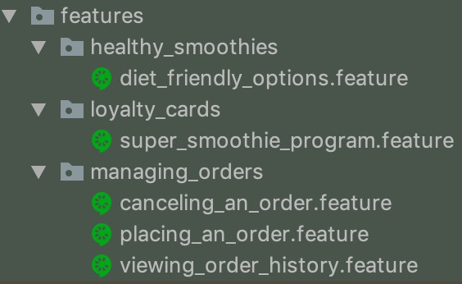


Slide 18
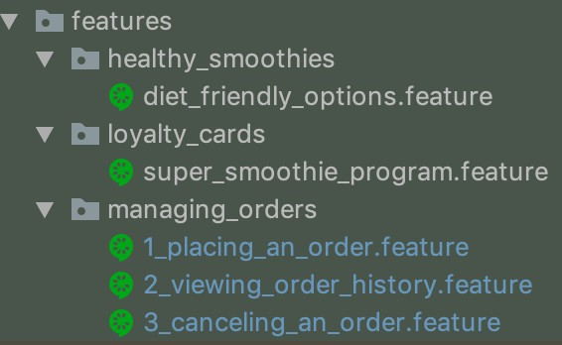

Slide 19

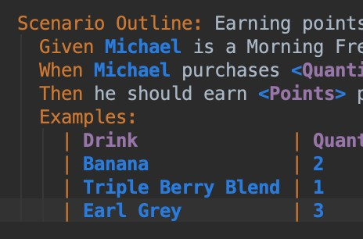



Slide 21

Feature: Diet-friendly Smoothies
Scenario Outline: Smoothies are organized into categories based on their number of calories
Scenario: Dieting members are shown which smoothies fit their diet
requirements
Scenario: Dieting members should be proposed healthy alternatives

Slide 22



Slide 23



























Slide 24
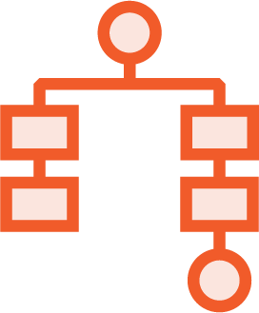









Slide 25

<dependency>
<groupId>io.cucumber</groupId>
<artifactId>cucumber-java</artifactId>
<version>4.2.0</version>
<scope>test</scope>
</dependency>
<dependency>
<groupId>io.cucumber</groupId>
<artifactId>cucumber-junit</artifactId>
<version>4.2.0</version>
<scope>test</scope>
</dependency>

Slide 26


<dependency>
<groupId>io.cucumber</groupId>
<artifactId>cucumber-java</artifactId>
<version>4.2.0</version>
<scope>test</scope>
</dependency>
<dependency>
<groupId>net.serenity-bdd</groupId>
<artifactId>serenity-core</artifactId>
<version>2.0.48</version>
<scope>test</scope>
</dependency>

Slide 27



<dependency>
<groupId>net.serenity-bdd</groupId>
<artifactId>serenity-cucumber4</artifactId>
<version>1.0.12</version>
<exclusions>
<exclusion>
<groupId>io.cucumber</groupId>
<artifactId>cucumber-core</artifactId>
</exclusion>
</exclusions>
</dependency>

Slide 28


<plugin>
<groupId>net.serenity-bdd.maven.plugins</groupId>
<artifactId>serenity-maven-plugin</artifactId>
<version>2.0.4</version>
<executions>
<execution>
<id>serenity-reports</id>
<phase>post-integration-test</phase>
<goals>
<goal>aggregate</goal>
</goals>
</execution>
</executions>
</plugin> `

Slide 29

import cucumber.api.CucumberOptions; import cucumber.api.junit.Cucumber; import org.junit.runner.RunWith;
@RunWith(Cucumber.class)
@CucumberOptions(features = "src/test/resources/features") public class AcceptanceTestSuite {}

Slide 30
import cucumber.api.CucumberOptions;
import net.serenitybdd.cucumber.CucumberWithSerenity; import org.junit.runner.RunWith;
@RunWith(CucumberWithSerenity.class)
@CucumberOptions(features = "src/test/resources/features") public class AcceptanceTestSuite {}

Slide 31






-
-
-
-

Slide 32


Slide 33





